Slide 1
Exercises TIME AND GLOBAL STATES
By Coulouris, Dollimore and Kindberg,

Slide 2
Question 1
See Section 10.1 for the necessity for clock synchronization.
Major design requirements:
i) there should be a limit on deviation between clocks or between any clock and UTC;
ii) clocks should only ever advance;
iii) only authorized principals may reset clocks (See Section 7.6.2 on Kerberos)
In practice (i) cannot be achieved unless only benign failures are assumed to occur and the system is
synchronous.

Slide 3
Question 2
ANS: Some applications use the current clock value to stamp events, on the assumption that clocks always advance.
We use E to refer to the ‘errant’ clock that reads 10:27:54.0 when the real time is 10:27:50. We assume that H
advances at a perfect rate, to a first approximation, over the next 8 seconds. We adjust our software clock S to
tick at rate chosen so that it will be correct after 8 seconds, as follows:
S = c(E - Tskew) + Tskew, where Tskew = 10:27:54 and c is to be found.
But S = Tskew+4 (the correct time) when E = Tskew+8, so:
Tskew+ 4 = c(Tskew + 8 - Tskew) + Tskew, and c is 0.5. Finally:
S = 0.5(E - Tskew) + Tskew (when Tskew ≤ E ≤ Tskew+8).

Slide 4
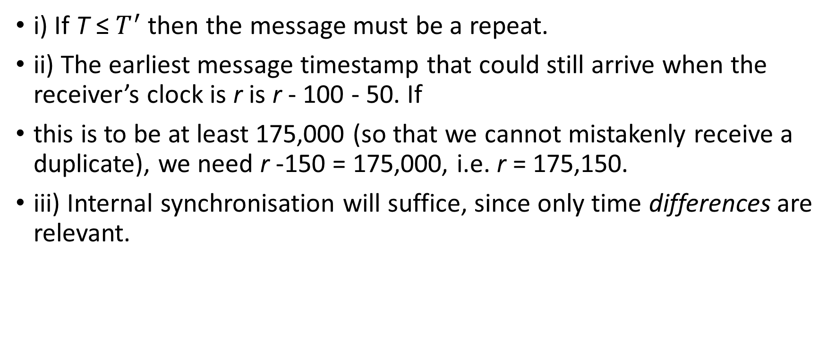
Question 3
i) If T ≤ $T^{′}$ then the message must be a repeat.
ii) The earliest message timestamp that could still arrive when the receiver’s clock is r is r - 100 - 50. If
this is to be at least 175,000 (so that we cannot mistakenly receive a duplicate), we need r -150 = 175,000, i.e. r = 175,150.
iii) Internal synchronisation will suffice, since only time differences are relevant.

Slide 5
Question 4
The client should choose the minimum round-trip time of 20 ms = 0.02 s. It then estimates the current time to
be 10:54:28.342 + 0.02/2 = 10:54:28.352. The accuracy is ± 10 ms.
If the minimum message transfer time is known to be 8 ms, then the setting remains the same but the accuracy improves to ± 2 ms.

